Slide 1
ORACLE COST-BASED OPTIMIZER BASICS
Randolf Geist
http://oracle-randolf.blogspot.com
info@sqltools-plusplus.org
Notes:
Welcome to this webinar. Thanks for taking your time to attend this session on the basic concepts of the Oracle Cost-Based Optimizer.
Note that most of these key concepts apply not only to Oracle but to other relational database management systems as well.
Display resolution: 1440*1050
Startup Database
Startup EMConsole
Start SQLTools++
Open:
Single Table Cardinality Demo
Join Cardinality Demo
Inter Table Clustering Demo
Blog post “How to cancel a query running in another session?”
http://oracle-randolf.blogspot.de/2011/11/how-to-cancel-query-running-in-another.html
Blog post “What-If Analysis Clustering Factor”
http://oracle-randolf.blogspot.de/2010/01/clusteringfactor-what-if-analysis.html
AllThingsOracle.com
http://allthingsoracle.com/author/randolf-geist/

Slide 2
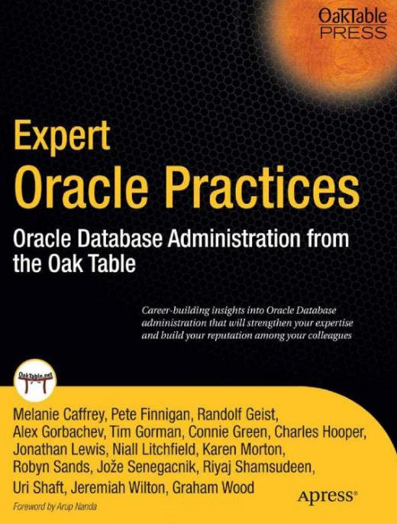


ABOUT ME
Independent consultant
  Available for consulting
  In-house workshops
    Cost-Based Optimizer
    Performance By Design
  Performance Troubleshooting
Oracle ACE Director
Member of OakTable Network
Notes:
Co-author of “Expert Oracle Practices”
Oracle ACE Director: Acknowledged by Oracle for community contributions
OakTable Network: Informal and independent group of people believing in a scientific approach towards Oracle

Slide 3
OVERVIEW
Optimizer Basics – Key Concepts
Proactive: Performance by design
Reactive: Troubleshooting
Notes:
This presentation focuses on the key concepts.
This knowledge can be used for both, proactive design for performance and troubleshooting.
Although proactive design and troubleshooting will also be touched, the key concepts are the main topic.
Towards the end of the presentation I’ll provide links to other resources covering the “performance by design” aspects

Slide 4
OPTIMIZER BASICS
Three main questions you should ask when looking for an efficient execution plan:
  How much data? How many rows / volume?
  How scattered / clustered is the data?
  Caching?
  => Know your data!
Notes:
If you were to find an efficient execution plan for a query, the main questions you would have to ask are these.
I’ll explain the meaning of each of these questions in the course of this presentation, but the main point here is that you need to know your data in order to answer these questions.

Slide 5
OPTIMIZER BASICS
Why are these questions so important?
  Two main strategies:
    One “Big Job”
    => How much data, volume?
    Few/many “Small Jobs”
    => How many times / rows?
    => Effort per iteration? Clustering / Caching
Notes:
In principle the optimizer has to decide between two choices:
A “big job” approach that tries to process data all at once
A “small job” approach where a subset of the data is processed iteratively, usually involving a pre-ordered or pre-clustered data set like an index that allows efficient access to a subset of the data
Note that in reality it is not that black & white, so an execution plan can consist of a mixture of both, but the point is still a very valid one.
Except for extreme cases, like picking a single row out of ten million, there is a huge “grey zone” where both approaches might be applicable.
So in order to decide between the two properly the efficiency of the two alternatives need to be determined: For the “small job” approach this is in particular how often it needs to be run and how much work each iteration requires.
(
In Data Warehouse appliances there is a trend to simplify things here by taking this decision out of the equation. For example there are some databases and appliances specifically designed for Data Warehouse workloads. They assume the majority of queries needs the “big job” approach anyway and therefore don’t support the small job approach, which means that some of them even don’t support indexes. They are optimized for running the “big job” approach as fast as possible, usually based on a shared-nothing, massive parallel design.
Note that even with such a simplification these systems can still suffer from poor execution plans, but it makes the life of the optimizer much easier. You can’t run OLTP like workloads though on such systems, because the majority of OLTP can only run efficiently when using the “small job” approach
Objective: Retrieve results with minimum effort
=> Efficient join order
)

Slide 6
OPTIMIZER BASICS
Optimizer’s cost estimate is based on:
  How much data? How many rows / volume?
  How scattered / clustered? (partially)
  (Caching?) Not at all
Notes:
It is probably not surprising that the cost estimate of Oracle’s optimizer is based on asking the same questions.
There are two significant differences how the optimizer approaches these questions. The first one is mentioned here, the second one will be explained later.
It might however be surprising that it doesn’t cover all the questions to the same extent. For example the optimizer at present only considers the clustering of data partially and doesn’t take caching into account at all.
This means that sometimes the optimizer might not be aware of important aspects of the application and data simply because the model at present doesn’t cover these aspects.

Slide 7
HOW MANY ROWS?
Single table cardinality
Join cardinality
Filter subquery / Aggregation cardinality
Notes:
So what is exactly meant by the question “How many rows?”
This topic can be broadly divided into these main categories.
Cardinality and Selectivity are two common terms in this context.
Cardinality simply means “number of rows”, and selectivity refers to the filter ratio, or basically “how many rows will remain after filtering or joining?”

Slide 8
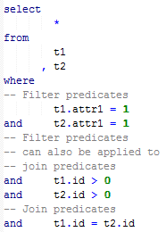
SINGLE TABLE CARDINALITY
Selectivity of predicates applying to a single table
Notes:
Single Table Cardinality: This is actually pretty straightforward. You need to consider all the filters that apply to each table only, ignoring any join predicates.

Slide 9
SINGLE TABLE CARDINALITY
Selectivity of predicates applying to a single table
Notes:
So these are the “Single Table” predicates for table T1 in this example

Slide 10
SINGLE TABLE CARDINALITY
Selectivity of predicates applying to a single table
Notes:
And likewise the same for T2.

Slide 11
SINGLE TABLE CARDINALITY
Selectivity of predicates applying to a single table
Filtered Cardinality / Filter Ratio
Base Cardinality
Notes:
The question then is: When looking at each table on its own (for example T1), how many rows are there in total and how many will remain after applying the filters relevant to this particular table, or in other words how many rows pass the filter predicates?
In fact you can verify this by running a simple SELECT COUNT(*) FROM T1 WHERE ATTR1 = 1 and ID > 0, so Single Table Cardinalities can be checked in an obvious way.

Slide 12
SINGLE TABLE CARDINALITY
Optimizer challenges
  Skewed column value distribution
  Gaps / clustered values
  Correlated column values
  Complex predicates and expressions
  Bind variables
Notes:
Although this might sound trivial, there are numerous challenges why the optimizer might have a hard time coming up with a reasonable estimate.
It is important to understand that what seems to be obvious to you is not necessarily obvious to the optimizer.

Slide 13
SINGLE TABLE CARDINALITY
Demo!
optimizer_basics_single_table_cardinality_testcase.sql
Notes:
Here’s the story: Suppose this simple two-table join represents an important senior management report that is not run very often, for example an end-of-month report. Of course in reality this query would be more complex, but this is sufficient to make the point.
The data set is slightly nasty since it models two optimizer challenges:
Attribute1 and 2 columns’ data is highly skewed
and furthermore the data of the two columns ATTR1 and ATTR2 is 100% correlated, which means that filtering on one of them is the same as filtering on both. This violates the “independence” assumption of the optimizer.
Let’s assume further Oracle determined automatically by means of the “Column Usage” monitoring and the “SIZE AUTO” feature that these two columns require
histograms so that the optimizer is able to detect the data skew.
The report is run several times with different inputs, and we can see that depending on the inputs the optimizer has correctly detected the skew and opted for either the “Big Job” or the “Small Job” approach – luckily the developers either accidentally or deliberately used literals instead of bind variables, which is a good thing in this case.
So far everything goes well and no-one is complaining about the performance.
Note that there is a potential flaw in the current implementation: Picking up ten rows from table T1 by using a full table scan could very likely be made more efficient by using an index, but since no-one is complaining about performance and the report is only run a couple of times at month end, no-one bothers to address this.
Now a request for change is raised where the developer works out that a function needs to be applied to both ATTR1 and ATTR2 because different kind of data is expected to be processed in the future.
Since there is no index on the columns the developer thinks that applying these functions looks like an innocent and simple change that cannot change much, since only a full table scan is available anyway. He even confirms this and sees that the data distribution for the current data is exactly the same as before and therefore happily brings the change into production.
Guess what happens next time the report is run for the large data set?
Regarding Troubleshooting: If you happen to have 11g and the Tuning Pack license, you can run the Real Time SQL Monitoring on this session. I believe Karen Morton will cover this and other ways of SQL statement monitoring in the next Webinar.
What has happened: First of all, the developer was right: The access path to T1 hasn’t changed, it is still a Full Table Scan. Due to the functions applied the optimizer however has lost track of the data skew and estimated that the Full Table Scan will return only 100 rows instead of the actual 900,000.
Therefore, based on this assumption, the optimizer preferred the “Small Job” approach, which turns out to be very inefficient under these circumstances. It would be pretty efficient if the assumption was correct, however.
So a wrong Single Table Cardinality estimate ruined the whole execution plan. It doesn’t require to imagine a more complex execution plan where more of these decisions have to be taken by the optimizer.
The problem is that the optimizer by default is trying to perform the optimization as fast as possible. Therefore it doesn’t look at the actual data but uses the statistics that have been pre-generated.
But this means that the optimizer can only see what is available from these statistics.
If the data is not represented well by the statistics, or even more specifically, if the questions asked by the queries are not represented well, the optimizer’s assumptions can be way off.
Here is an important point: It doesn’t matter how fresh your statistics are (although stale statistics can be a problem), if the statistics aren’t representative then the optimizer will be easily mislead.
Therefore you not only have to ask yourself if your statistics are up-to-date, but whether the statistics are representative for your data and queries or not.
Usually, if the assumptions of the optimizer were true, the resulting execution plans would perform reasonably. The potential inefficiency is caused by the wrong assumptions.
There is a wonderful optimizer feature called “Dynamic Sampling” where the optimizer actually looks at a small sample set of the data. Of course this adds overhead to the optimization phase so it is not always applicable, and depending on the data distribution it might not always be helpful, but it sometimes it can be very handy allowing to arrive at a reasonable Single Table Cardinality estimate.
I’ve started a series on AllThingsOracle.com where I highlight different aspects of Dynamic Sampling.
Note also that the SQL Tuning Advisor (available with Enterprise Edition + Diagnostic + Tuning Pack license) actually runs a given statement partially to determine exactly these cardinalities – it looks at the actual data. But then the runtime of that so called “Offline Optimization” is measured in minutes, not fraction of a second.

Slide 14
SINGLE TABLE CARDINALITY
Impact NOT limited to a “single table”
Influences the favored Single Table Access Path (Full Table Scan, Index Access etc.)
Influences the Join Order and Join Methods (NESTED LOOP, HASH, MERGE)
=> An incorrect single table cardinality potentially screws up whole execution plan!
Notes:
So here is the main takeaway for the Single Table Cardinality:
It looks trivial and can be verified in a simple way, but the optimizer by default uses the available statistics to come up with an estimate that might be way off if the statistics are not representative
A wrong Single Table Cardinality estimate can ruin the whole execution plan – it potentially echoes through the whole plan
There is literally an arsenal of features at yours and the database’s disposal that can be used to help the optimizer arriving at an improved Single Table Cardinality
At least for your critical queries you should verify that these estimates are in the right ballpark
By doing so you probably eliminate the most common source for bad decisions of the optimizer

Slide 15
JOIN CARDINALITY
Oracle joins exactly two row sources at a time
If more than two row sources need to be joined, multiple join operations are required
Many different join orders possible (factorial!)
Notes:
Joins are a different story for several reasons.
The first important point to understand is that Oracle joins at most two row sources at a time. If you need to join more tables, multiple join operations are required.
This also means that there are potentially a huge number of possibilities how these tables could be joined. This makes this already a non-trivial task.

Slide 16
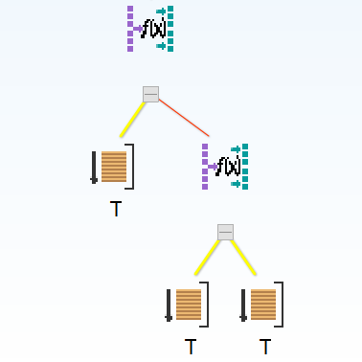
JOIN CARDINALITY
Tree shape of execution plan
Notes:
An execution plan for a simple three table join therefore could look like this. Either a join will join actual tables or it will join the result of other join operations.

Slide 17
JOIN CARDINALITY
Challenges
  Getting the join selectivity right!
  A join can mean anything between no rows and a Cartesian product
Notes:
There are actually two challenges when it comes to joins:
The first one is that the optimizer needs to work out how selective a join is meaning how many rows will remain after the join. The problem here is that a join between two rowsources can result in anything between zero rows and a Cartesian product. This is an impressive range and again makes this a non-trivial task.

Slide 18
JOIN CARDINALITY
Getting the join selectivity right
T1, T2
1,000,000 rows
0 rows
T1
T2
1,000 rows
1,000 rows
Notes:
So taking two row sources that return 1,000 rows each I can end up with anything between 0 and 1,000,000 rows.

Slide 19
JOIN CARDINALITY
Getting the join cardinality right
Join cardinality =
Cardinality T1 *
Cardinality T2 *
Join selectivity
T1, T2
T1
T2
Notes:
The second problem of the join is that its final join cardinality – the resulting number of rows – depends ultimately on the Single Table Cardinality estimates of the tables joined. This is the explanation why a wrong Single Table Cardinality estimate echoes through the whole execution plan.
So even if the optimizer gets the join selectivity estimate right, the resulting cardinality might be way off if the Single Table Cardinality of the tables joined is wrong.
This is exactly what happened in my previous demonstration. If my demo included further joins these operations would have been affected by the wrong join cardinality estimate caused by the incorrect Single Table Cardinality estimate.

Slide 20
JOIN CARDINALITY
Challenges
  Semi Joins (EXISTS (), = ANY())
  Anti Joins (NOT EXISTS (), <> ALL())
  Non-Equi Joins (Range, Unequal etc.)
Notes:
Again, similar to the Single Table Cardinality there are numerous challenges and reasons why the optimizer might get the join selectivity wrong. In particular non-equi joins and anti-joins can be hard to predict.

Slide 21
JOIN CARDINALITY
Even for the most common form of a join
- the Equi-Join –
there are several challenges
  Non-uniform join column value distribution
  Partially overlapping join columns
  Correlated column values
  Expressions
  Complex join expressions (multiple AND, OR)
Notes:
And even for the most common form of a join – the Equi-Join – there are lots of scenarios that can mislead the optimizer.

Slide 22
JOIN CARDINALITY
Demo!
optimizer_basics_join_cardinality_testcase.sql
Notes:
Again a simple two table join. Note that the foreign key in T is highly skewed: The majority of rows are mapped to the same entry in the parent table D. There are proper primary and foreign key constraint enabled and validated on these tables.
When looking at the actual data distribution it is obvious to us that filtering that single row in D where most rows in T are mapped to and joining to T will result in the majority of rows from T returned, likewise when filtering on any other row in D only a few rows will be returned from the join.
But this is not obvious to the optimizer. It only sees that there are 1,000 different values in D and therefore filtering on one will map on average to 1,000 rows of T.
Now if you watched closely you might argue that I have forgotten to tell the optimizer about the skew in the column FK, and you would be right.
So let’s add a histogram on the FK column. As you can see the optimizer is now aware of the skew in the column values.
But in fact the histogram doesn’t change the outcome of the join. You might ask: Why?
Simply because the optimizer doesn’t have a clue that filtering on DESC1 corresponds to the Primary Key of 1, and therefore when generating the execution plan the optimizer cannot see the massive skew in the join.
So again your mantra should be: What seems to be obvious to you isn’t necessarily obvious to the optimizer.

Slide 23
JOIN CARDINALITY
Influences the Join Order and Join Methods
(NESTED LOOP, HASH, MERGE)
=> An incorrect join cardinality/selectivity potentially screws up whole execution plan!
Notes:
So the main takeaways for the join cardinality is this:
Checking join selectivities is a non-trivial task because there can be potentially a huge number of join combinations that need to be evaluated. If you want to do similar things as with the Single Table Cardinality you would to evaluate either all or none of them
This is the reason why many of the features that can be helpful for improving Single Table Cardinality estimates (for example, Dynamic Sampling or Cardinality Feedback, etc.) are not really useful for improving join selectivities
Join Cardinalities are affected by Single Table Cardinality estimates. This is the reason why wrong Single Table Cardinalities do have a global impact on an execution plan
Correcting wrong join selectivity estimates can be a tricky thing

Slide 24
HOW SCATTERED / CLUSTERED?
Data is organized in blocks
Many rows can fit into a single block
According to a specific access pattern data can be either scattered across many different blocks or clustered in the same or few blocks
Does make a tremendous difference in terms of efficiency of a “Small Job”
Notes:
The “How many rows” question tells us how often a “Small Job” might have to be executed. The “How scattered / clustered” (and “Caching”) question is about how efficient such an iteration of a small job might be.

Slide 25
HOW SCATTERED / CLUSTERED?
1,000 rows => visit 1,000 table blocks: 1,000 * 5ms = 5 s
Notes:
This is a picture of a typical index range scan operation. First the index tree is traversed from the root block via the branch blocks to the leaf blocks according to the start value of the index access predicate. Now the index leaf blocks are scanned until the end value of the index access predicate is exceeded. This is usually a quite efficient operation. First of all the number of steps to identify a leaf block is determined by height of the index tree. This is even for very large indexes usually no more than five steps.
Then the leaf blocks are representing a doubly linked list, so from here the database only needs to process the leaf blocks one after the other (if more than a single leaf block needs to be visited) according to the order defined in the index.
The usually far less predictable part is the table access (if necessary!). The nasty part in case of data scattered across the corresponding table according the index order is that for each single row identified in the index potentially another table block needs to be visited. Since each block might contain many other rows, this means a lot of “collateral data” in the buffer cache if these rows are not of interest to other, concurrently running queries.
Furthermore in worst case each of these blocks are not yet in the buffer cache and need to be read into it, which on spinning disk nowadays takes approximately 5 ms on average.
Not only that, if many blocks need to be read into the buffer cache, it might even happen that blocks need to be read multiple times into the cache since they were already aged out before being accessed again.
This means that potentially more blocks might be read into the cache than the table is in size if not all blocks already read can be kept in the cache – in worst case simply by accessing more rows than blocks.
Also think of the potential side effects of such an operation: Any other query relying on buffers kept in the cache might compete with this query. It’s even possible to affect the performance of ongoing DML operations, because the dirty blocks usually written in a lazy manner by the Database Writer need to be written much faster now simply because there is a demand for free blocks in the buffer cache in order to read the blocks into it.

Slide 26
HOW SCATTERED / CLUSTERED?
1,000 rows => visit 10 table blocks: 10 * 5ms = 50 ms
Notes:
Compare this to the same amount of rows processed in case of clustered table data: It’s not unlikely to have 100 or more rows in a single block, so in worst case only ten blocks need to be visited and read into the buffer cache. What a tremendous difference!
Note that this also means that sometimes it is more efficient to visit more rows that are clustered together instead of visiting less rows that are scattered across many blocks, for example it is probably much more efficient to access 1,000 rows clumped together in 10 blocks rather than accessing 200 rows across 200 blocks.

Slide 27
HOW SCATTERED / CLUSTERED?
Scattered data means potentially many more blocks to compete for the Buffer Cache for the same number of rows
=> Caching!
Scattered data can result in increased
  physical disk I/O
  logical I/O
  write disk I/O (Log Writer, DB Writer)
  free buffer waits
Notes:
So scattered / clustered data is closely related to caching. A badly scattered table data might have all kinds of side effects on other concurrent activity in the database. It is not limited to the query itself that is suffering from the frequent random access to blocks.

Slide 28
HOW SCATTERED / CLUSTERED?
Most OLTP data has a natural clustering
Data arriving around the same time is usually clustered together in a heap organized table
Depends on the physical organization
Partitioning for example can influence this clustering even for heap organized tables
Notes:
Heap organized tables are the default in Oracle. Data is not stored according to any particular order or clustering – rows can be stored in an arbitrary block of the table.
Nevertheless data that arrives at the same time is usually clustered together in the same table blocks.
But this behaviour can be influenced by options available that influence how data is stored. For example hash-partitioning a heap organized table might lead to a different clustering of data.

Slide 29
HOW SCATTERED / CLUSTERED?
Clustering of data can be influenced by physical implementation
Physical design matters
  Segment space management (MSSM / ASSM)
  Partitioning
  Index/Hash Cluster
  Index Organized Tables (IOT)
  Index design / multi-column composite indexes
There is a reason why the Oracle internal data dictionary uses clusters all over the place
Notes:
Here is an important point: Ideally already at design time the data and the critical queries should be known and taken into account. This knowledge can then be used to assess whether any alternatives to heap organized tables could improve the efficiency of those queries without sacrificing too much DML performance. Pre-joining data in clusters or pre-ordering data in Index Organized Tables can make a tremendous difference.
Be aware of the fact that the default ASSM automatic segment space management spreads inserts across several blocks rather than using the same block as manual segment space management does without the definition of multiple freelist / freelist groups. This feature of ASSM has a significant effect on the clustering of data. Although data arriving at the same time is still clustered together across a few blocks, this can have some interesting side effects on the clustering factor calculation Oracle performs when gathering statistics.
Also note that even with heap organized tables a good index design can make a tremendous difference in performance. In particular careful design of composite and function-based indexes can make a huge difference.

Slide 30
HOW SCATTERED / CLUSTERED?
No table access => only index blocks are visited!
Notes:
Compare the previous description to the work required for an index range scan operation where no random table access is required – this can be achieved by using a so called covering index on a heap organized table or using an Index Organized Table.
Of course the index will be much bigger in such cases but the random table access is avoided – the efficiency of the operation largely depends on how randomly the index blocks are scattered.

Slide 31
HOW SCATTERED / CLUSTERED?
There is only a single measure of clustering in Oracle:
The index clustering factor
The index clustering factor is represented by a single value
The logic measuring the clustering factor by default does not cater for data clustered across few blocks (ASSM!)
Notes:
How does the optimizer know about the scattering / clustering of data?
There is only a single measure: The index clustering factor that describes the randomness of the table data according to the order defined by the index.
Oracle determines the clustering factor by “walking” the index in order and looking at the resulting table block location. For every row where the table block changes, the clustering factor is increased. So in principle the clustering factor can be as low as the number of table blocks covered by the index, but it can also be as high as the number of rows in the index.
There is however a potential flaw in the way Oracle determines the clustering factor. If the table data is clumped together across a few blocks so that Oracle just has to jump forth and back between a couple of blocks rather than actually randomly jumping to different blocks then the clustering factor might not be representative.
Note that this spread of table data across a few blocks is a default behaviour of ASSM. So any concurrent inserts writing into tables residing in a ASSM tablespace might suffer from this problem.
(It is only a single value for a given table / index combination, so it represents an average value. It therefore cannot represent any specific clustering in a certain area of the table. For example a re-organization or a shrink space operation might lead to a re-arrangement of older data where the clustering of newly arriving data is different from the remaining data. This is however not a very common problem so the single value should be sufficient and representative in most cases.
)

Slide 32
HOW SCATTERED / CLUSTERED?
Challenges
  Getting the index clustering factor right
  There are various reasons why the index clustering factor measured by Oracle might not be representative
    Multiple freelists / freelist groups (MSSM)
    ASSM
    Partitioning
    SHRINK SPACE effects
Notes:
There is a potential trap waiting in the way Oracle determines the clustering factor. If the table data is clumped together across a few blocks so that Oracle just has to jump forth and back between a couple of blocks rather than actually randomly jumping to different blocks then the clustering factor might not be representative.
Note that this spread of table data across a few blocks is a default behaviour of ASSM. So any concurrent inserts writing into tables residing in a ASSM tablespace might suffer from this problem.

Slide 33
HOW SCATTERED / CLUSTERED?
Re-visiting the same recent table blocks
Notes:
This is again the known picture of a typical index range scan operation. Now the important point here is that although Oracle has to jump to a different block for every row and therefore increases the clustering factor for every row when gathering statistics, it re-visits the same recent blocks rather than jumping to a totally random block. Therefore it is very likely that these recently visited blocks are already in the cache and don’t require physical I/O to be read into the buffer cache. This can make a huge difference between the efficiency suggested by the bad clustering factor and the actual efficiency of the operation.
I do have a demo about this, too, but probably don’t have enough time for it.

Slide 34
HOW SCATTERED / CLUSTERED?
Challenges
  There is no inter-table clustering measurement
  The optimizer therefore doesn’t really have a clue about the clustering of joins
  You may need to influence the optimizer’s decisions if you know about this clustering
Notes:
So far we have only looked at intra-table clustering, which means clustering between a table and its indexes.
But there can be a similar clustering or scattering when doing “Small Job” processing and joining tables.
Oracle doesn’t measure any “inter-table” clustering, so the optimizer doesn’t have a clue regarding this.
Therefore it calculates any iterative “Small Job” work the same based on the assumption that any assumed I/O will be physical I/O.

Slide 35
HOW SCATTERED / CLUSTERED?
Notes:
This is a picture of a typical Nested Loop join. The driving row source in this case is a full table scan, but could also be an index range scan that again could change the order of the rows coming from the driving row source.
For every row of the driving row source an index scan followed by a table lookup is performed.
Notice that in that scenario usually more index than table blocks will be accessed since the index needs to be traversed for every iteration.
Oracle addresses at runtime by applying different optimizations: The root block of the index will be pinned lowering the overhead of each buffer visit and the branch blocks will be accessed in a special mode that again lowers the contention overhead.
Since indexes tend to be smaller than tables often index blocks are better cached than table blocks.
So again quite often the actual threat of such an operation is the random lookup to table rows.
Oracle doesn’t know if the table blocks visited will be clustered or scattered for such an operation, but it can make a tremendous difference in performance.

Slide 36
HOW SCATTERED / CLUSTERED?
Notes:
This the same operation, but in this case the table blocks visited are clustered together according to the driving row source.
Both scenarios will usually lead to similar costs but their actual runtime can be vastly different.

Slide 37
HOW SCATTERED / CLUSTERED?
Notes:
And just for your entertainment, this is the same operation when using a pre-join table cluster. Since Oracle knows that the data resides in the same block in a well designed cluster it can immediately read the joined data from the very same block as the driving row source.
This not only looks far simpler but usually is also much more efficient at query time.
Of course a lot of things need to be considered when dealing with clusters, otherwise Oracle would use a similar approach by default (no “Silver Bullet”).

Slide 38
HOW SCATTERED / CLUSTERED?
Demo!
optimizer_basics_inter_table_clustering_testcase.sql
Notes:
In order to demonstrate the vast difference in runtime performance that clustering can make, let’s take the first example I’ve used and change the inter-table clustering.
Looking at the original table creation script it becomes obvious that one table uses a random distribution of the IDs whereas the other one uses a monotonically increasing value.
Therefore the bad execution plan using the “Small Job” approach suffered from the scattered access to T2 according to the IDs coming in random order from the driving row source T1.
That’s the main reason why the performance at runtime was so bad.
Let’s have a quick look at the cost estimate of that configuration.
Now I’ll re-create T2 using the natural order of rows in T1 and gather statistics in the same way.
As you’ll notice the cost estimate is pretty much identical to the previous setup.
But look at the impressive difference at runtime!
Note that this of course doesn’t mean that this execution plan is the most efficient one; what has been discussed before does still apply

Slide 39
CACHING
The optimizer’s model by default doesn’t consider caching of data
Every I/O is assumed to be physical I/O
But there is a huge difference between logical I/O (measured in microseconds) and physical I/O (measured in milliseconds)
Notes:
I don’t have much to say about caching here, although a lot could be said when time permits.
The main point here is that the optimizer doesn’t consider caching by default, so the costing is purely based on the assumption that every I/O is physical I/O.
But, as we’ve already seen in the previous section there is a huge difference between physical and logical I/O.

Slide 40
CACHING
You might have knowledge of particular application data that is “hot” and usually stays in the Buffer Cache
Therefore certain queries against this “hot” data can be designed based on that knowledge
The optimizer doesn’t know about this. You may need to influence the optimizer’s decisions
Notes:
If you happen to know that certain data of your application is very likely to be buffered in the cache then you can use this knowledge to design your query accordingly.
You can query the Buffer Cache meta data information available in the database to get an idea which parts of which segments frequently are cached.
Since the optimizer is not aware of that caching you might need to influence the optimizer’s decisions for critical queries.
(Depending on the individual circumstances this can be achieved by using the OPTIMIZER_INDEX_COST_ADJ and / or OPTIMIZER_INDEX_CACHING parameter on statement level as hints or by specifying the join order and access methods.)

Slide 41
CACHING
Oracle obviously played with the idea of introducing an per object caching component into the cost calculation in 9i and 10g
You can see this from the undocumented parameters _optimizer_cache_stats and _cache_stats_monitor as well as the columns AVG_CACHED_BLOCKS and AVG_CACHE_HIT_RATIO in the data dictionary
Notes:
There was some beta optimizer code introduced in the 9i and 10g releases that suggested that Oracle experimented with a costing based on per object caching information, but it hasn’t made it (yet) into production code.
Note that there are two parameters OPTIMIZER_INDEX_COST_ADJ and OPTIMIZER_INDEX_CACHING that allow to introduce a general cost reduction for index based access paths and the inner row sources of Nested Loop joins.
Although these parameters might be helpful under certain circumstances the problem of these is the granularity: They by default are applied to every execution plan, not taking into account that only certain objects or more specifically only certain areas of such objects might be subject to significant caching.
Therefore these parameters could be used on statement level as hints for particular statements that are known to benefit from caching.
In recent Oracle related publications it is often mentioned that rather than using these two parameters System Statistics should be used instead.
However, System Statistics are available to the optimizer in order to improve the costing of physical I/O by allowing to cost single block and multi block reads differently, something that the cost-based optimizer didn’t take into account in previous versions.
The two mentioned parameters are therefore probably still applicable if one wants to make the optimizer aware of certain caching related aspects.

Slide 42
CACHING
It is important to point out that even logical I/O is not “free”
So even by putting all objects entirely in the Buffer Cache inefficient execution plans may still lead to poor performance
Excessive logical I/O, in particular on “hot blocks”, can lead to latch contention and CPU starvation
Notes:
Just as a final word about Caching: An inefficient execution plan can still lead to poor performance even with all objects being cached, either by using an inefficient join order that causes Oracle to work excessively, and / or by causing contention in the Buffer Cache.
Oracle needs to serialize certain code paths that signal to other processes that a block is going to be accessed in order to avoid data corruption of the data in memory.
Excessive logical I/O can lead to contention in those serialization code paths (so called “latch contention”). Usually this also leads to excessive CPU usage.
So even with a large amount of cache efficient execution plans are still required in order to make good use of the resources available.

Slide 43
SUMMARY
Cardinality and Clustering determine whether the “Big Job” or “Small Job” strategy should be preferred
If the optimizer gets these estimates right, the resulting execution plan will be efficient within the boundaries of the given access paths
Know your data and business questions
Notes:
And remember the mantra: Although something might look obvious to you it is not necessarily obvious to the optimizer.

Slide 44
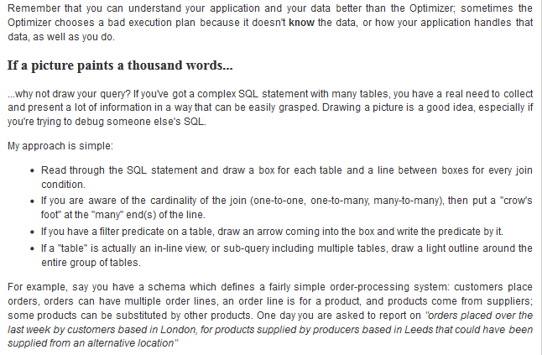
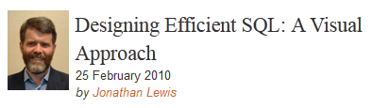
PERFORMANCE BY DESIGN
How to apply these concepts, where to go from here?
  Read Jonathan Lewis’ article “Designing Efficient SQL” at Red Gate’s “Simple Talk”
  Probably the best coverage of the concepts outlined here including clustering and caching
  http://www.simple-talk.com/sql/performance/designing-efficient-sql-a-visual-approach/
Notes:
If I made you curious enough and before we come to the Q&A section, if you would like to get more information about the topics discussed, here are some links to recommended material for further reading and self-study.
Jonathan Lewis published a brilliant paper where you can see the fascinating process of literally designing a query for performance. It is based on his “Writing efficient SQL” seminar and shows how to apply the key concepts discussed here in a creative way to arrive at an efficient execution plan by knowing the data and the business question asked by the query. It also demonstrates how you could “visualize” your query.
Surprisingly this publication can be found on “SimpleTalk.com” which happens to be the SQLServer knowledge base by RedGate Software.
However, since the key concepts apply to most relational database systems, it doesn’t really matter that it is using SQLServer terms and it definitely a recommended read.

Slide 45
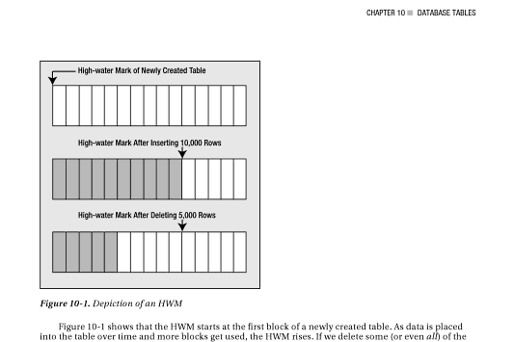
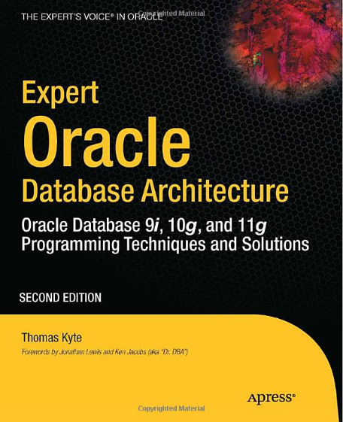
PERFORMANCE BY DESIGN
How to apply these concepts, where to go from here?
  Read one of Tom Kyte’s books to learn more about the pro’s and con’s of clusters and index organized tables
Notes:
Before you rush off and start creating your next objects using only clusters and Index Organized Tables, it is a good idea to take for example one of the copies of your favorite Tom Kyte book and read again about the advantages and disadvantages of the alternatives to Heap Organized Tables.
You need to understand the implications of using such objects like clusters or Index Organized Tables otherwise improper usage might lead to all kinds of problems.

Slide 46
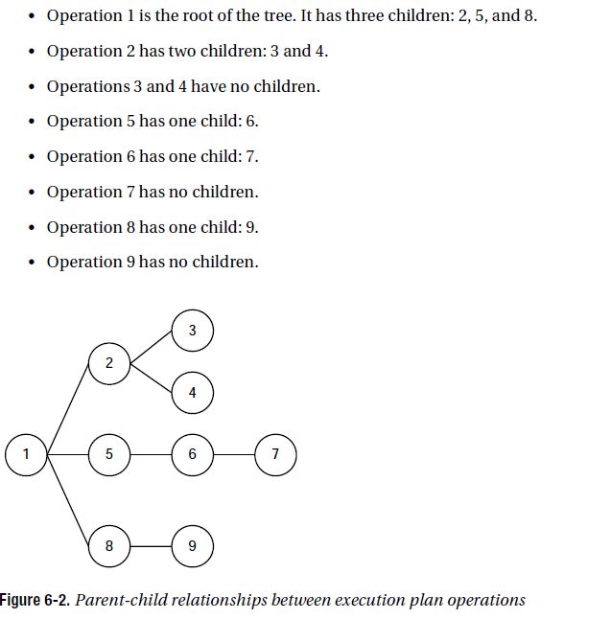
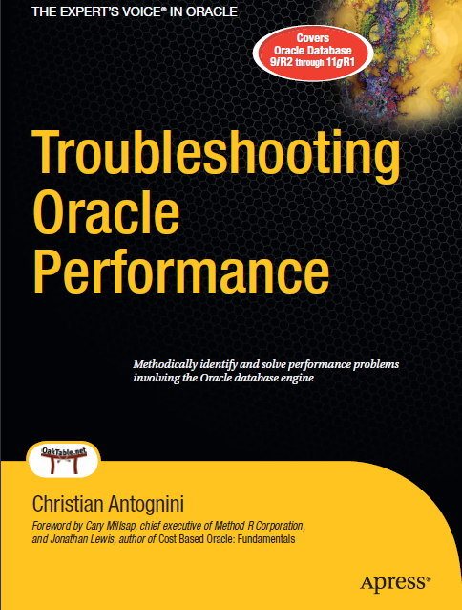
PERFORMANCE BY DESIGN
How to apply these concepts, where to go from here?
  Learn how to read, interpret and understand Oracle execution plans
  => Chapter 6 of “Troubleshooting Oracle Performance” by Christian Antognini
  This knowledge is required in order to compare your understanding of the query to the optimizer’s understanding
Notes:
If you think you have a reasonable idea about how an efficient execution plan of your query might look like you probably want to make sure that the plan suggested by the optimizer corresponds to that.
It is however surprisingly hard to find a reasonable description how to read and understand the plan descriptions provided by Oracle.
Without proper understanding of that plan description it is obviously not possible to compare the execution plan suggested by Oracle with your idea of the execution plan.
The best instructions how to read and understand execution plans available so far I’ve found in Christian Antognini’s book “Troubleshooting Oracle Performance”, chapter 6.
Apart from that it is probably still the best book around on the topic of Performance Troubleshooting and therefore a highly recommended read anyway.

Slide 47
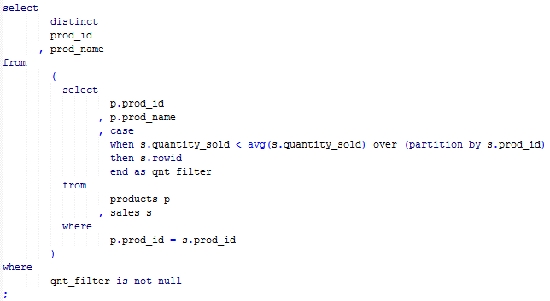
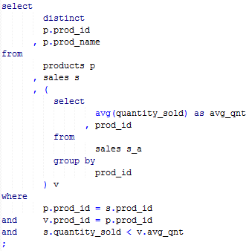
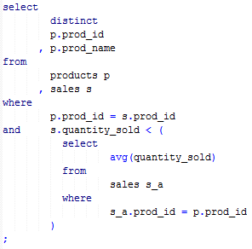
PERFORMANCE BY DESIGN
How to apply these concepts, where to go from here?
  Be aware of Query Transformations: The optimizer might rewrite your query to something that is semantically equivalent but potentially more efficient
  This might take you by surprise when trying to understand the execution plan favored by the optimizer
Query transformation examples by courtesy of Joze Senegacnik (OOW 2010)
Notes:
Once you are able to interpret the plan description provided by Oracle you might be surprised by some of the execution plans that you encounter.
One of the reasons for such surprises are so the called “Query Transformations” that the optimizer applies to your SQL statement, which means that the optimizer rewrites your query into a different one guaranteed to return the same result.
The only purpose of such rewrites to semantically equivalent SQL statements is performance: Oracle attempts to find alternative ways to express the same query that open up different and more ways to execute the statement.
With every release Oracle adds more transformation capabilities to the optimizer.
Here is one example of such a transformation: Before you start asking the important questions about the aggregate subquery you might realise that the optimizer turned the aggregate subquery into an equivalent join, or might even be able to eliminate the subquery at all and turn the subquery into an analytic function.
Of course even with this cunning optimization in place you still would need to ask the question: How many rows will be returned by this query if this was part of a more complex execution plan.

Slide 48
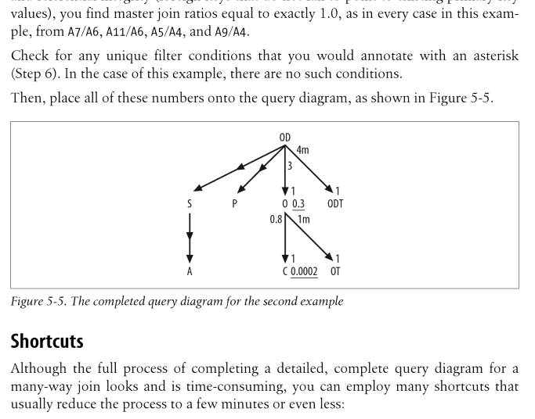
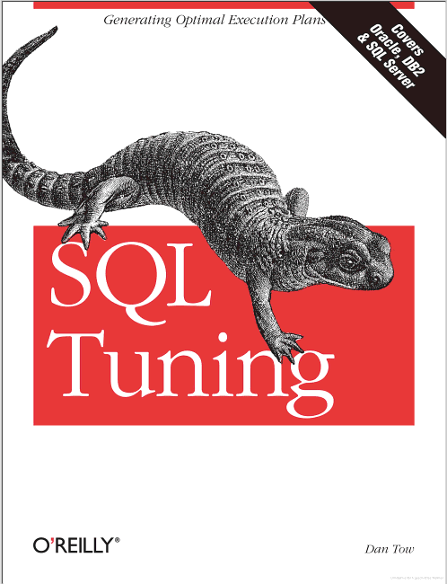
PERFORMANCE BY DESIGN
If you want a more formal approach
  Read “SQL Tuning” by Dan Tow
    Teaches a formal approach how to design and visualize an execution plan
    Focuses on “robust” execution plans in an OLTP environment
    The formal approach doesn’t take into account clustering and caching, however it is mentioned in the book at some places
Notes:
If you are interested in a more formal approach how you can design queries for performance and arrive at an efficient execution plan then I recommend reading “SQL Tuning” by Dan Tow. It focuses on developing “robust” execution plans in an OLTP environment, which means primarily finding an efficient application of the “Small Job” strategy.
The book also teaches a formal approach how to “draw” a picture of the execution plan which can be very helpful for visualization purposes.
It covers not only Oracle but also other relational database systems, like SQL Server and DB2.

Slide 49
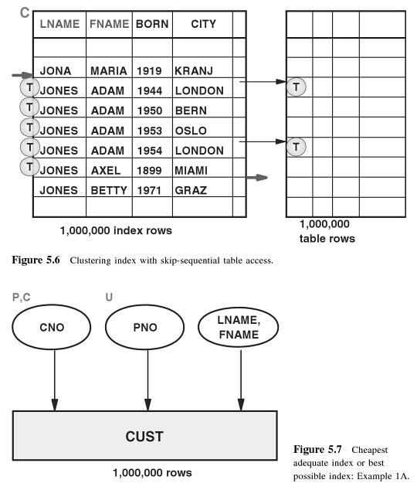
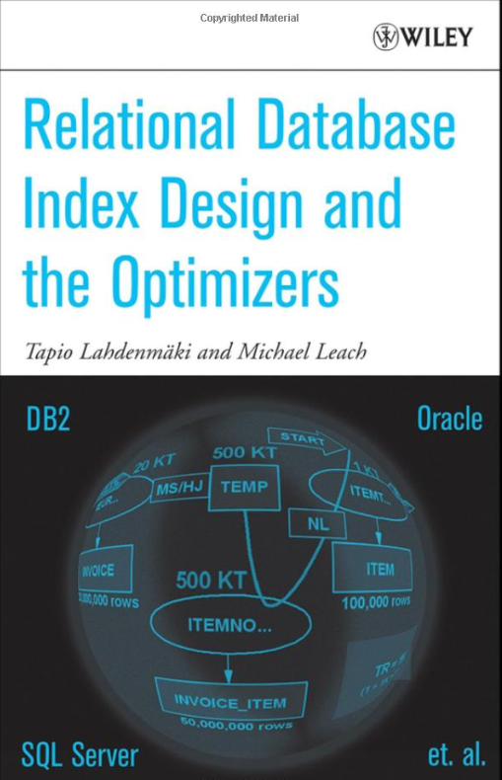
PERFORMANCE BY DESIGN
If you want a more formal approach
  Read “Relational Database Index Design and the Optimizers” by Tapio Lahdenmäki and Michael Leach
    Focuses on index design
    Provides simple and more advanced formulas allowing to predict the efficiency of queries and indexes
    Covers clustering and caching
Notes:
As already outlined in the data scatter / clustering section a good index design can make a tremendous difference to performance.
It is therefore highly recommended to read this book as it provides many examples and formulas that allow predicting the efficiency of indexes and queries.
Again this book cover several database vendors, since most of the concepts apply to all of them.

Slide 50
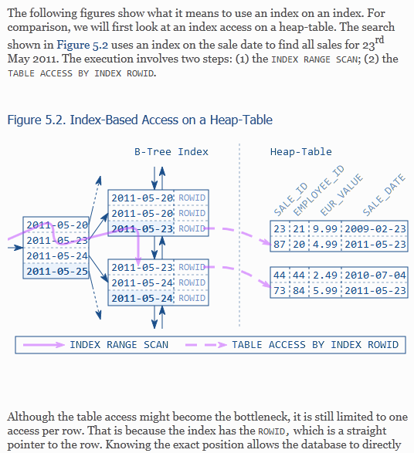

PERFORMANCE BY DESIGN
For application developers
  Read “Use the Index, Luke” by Markus Winand
    Focuses on index design
    Provides a lot of examples how to design efficient database access using different front-end languages (Java, Perl, PHP, etc.)
    Also available as free eBook
    Cross database (Oracle DB2, MySQL…)
http://use-the-index-luke.com/
Notes:
Another good online resource on the topic of proper indexing is this.
Besides explaining indexing strategies it is in particular helpful to developers because it also focuses on how to access the database efficiently using different languages like Java, Perl, PHP etc.

Slide 51
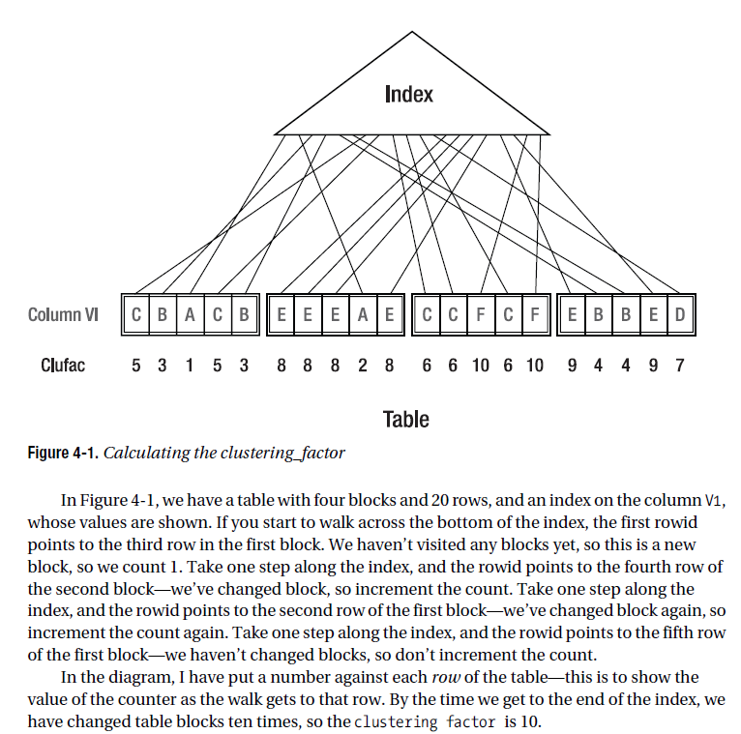
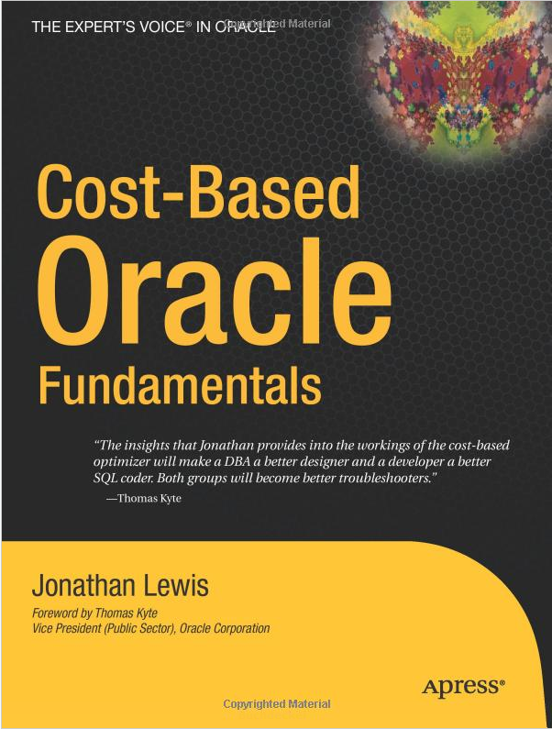
PERFORMANCE BY DESIGN
If you want dive into the details of the Cost-Based Optimizer
  Read “Cost-Based Oracle: Fundamentals” by Jonathan Lewis
    Almost six years old
    Still the best book about the Oracle optimizer
    Covers the key concepts mentioned here in great detail
Notes:
Of course Jonathan Lewis’ book on the Cost-Based Optimizer needs to be mentioned here as well. If you want to dive deeper into optimizer topics, here you’ll find the answers.

Slide 52
QUESTIONS & ANSWERS
Q & A

